Slide 1
NSE Akamai CDN Usage & Interactions

Slide 2
Akamai usage for NSE Parivartan
Akamai Solution | Applicability for NSE Parivartan
Security Solutions | Amongst numerous solutions under Security Solutions - Web Applications Security solutions are applicable for NSE They provide protection against DoS, DDoS, Sql Injection, Cross Site scripting etc. Data Center Security, DNS Services, Customer Identity & Access Management, Malware and Phising solutions, etc. are not applicable at this point
Web Performance Solutions | Amongst numerous solutions under Web Performance Solutions – Accelerate Solutions that offers Intelligent automation and controls to maximize user experiences on web, iOS, and Android apps are applicable. Parivartan can use it for caching static content such as images, CSS, Java script files etc. Serverless Solutions, API Gateway, IoT Solutions are not applicable at this point
Media Delivery Solutions | Not applicable for Parivartan as this is for large scale media/video content
Network Operator Solutions | Not applicable for Parivartan as this is for Network operators
Professional Services | To be decided later
Detailed analysis need to be performed to select the specific Akamai offering

Slide 3
CDN Usage for NSE Parivartan
NSE DC (and DR)
NSE Primary Server
(Nginx/ API GW)
Local ISP
Akamai Edge Server
Akamai Edge Server
Trading Member
Firewall (allows traffic only from CDN)
NSE Secondary Server (Nginx/ API GW)
Akamai Edge Server
Akamai Edge Server
Local ISP
Clearing Member

Slide 4
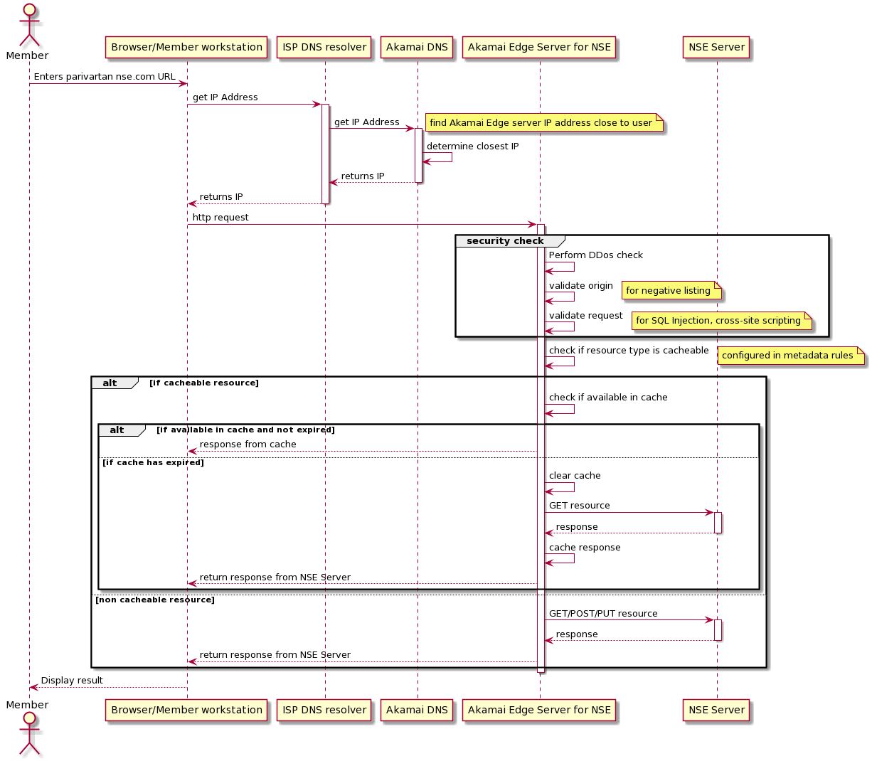
NSE – Akamai CDN Interaction
The security checks indicated above are part of Akamai’s Security Solutions
Notes:
@startuml
actor Member
Member -> "Browser/Member workstation" : Enters parivartan nse.com URL
"Browser/Member workstation" -> "ISP DNS resolver" : get IP Address
activate "ISP DNS resolver"
"ISP DNS resolver" -> "Akamai DNS" : get IP Address
activate "Akamai DNS"
note right: find Akamai Edge server IP address close to user
"Akamai DNS" -> "Akamai DNS" : determine closest IP
"ISP DNS resolver" <-- "Akamai DNS" : returns IP
deactivate "Akamai DNS"
"Browser/Member workstation" <-- "ISP DNS resolver" : returns IP
deactivate "ISP DNS resolver"
"Browser/Member workstation" -> "Akamai Edge Server for NSE" : http request
activate "Akamai Edge Server for NSE"
group security check
"Akamai Edge Server for NSE" -> "Akamai Edge Server for NSE" : Perform DDos check
"Akamai Edge Server for NSE" -> "Akamai Edge Server for NSE" : validate origin
note right: for negative listing
"Akamai Edge Server for NSE" -> "Akamai Edge Server for NSE" : validate request
note right: for SQL Injection, cross-site scripting
end
"Akamai Edge Server for NSE" -> "Akamai Edge Server for NSE" : check if resource type is cacheable
note right: configured in metadata rules
alt if cacheable resource
"Akamai Edge Server for NSE" -> "Akamai Edge Server for NSE" : check if available in cache
alt if available in cache and not expired
"Akamai Edge Server for NSE" --> "Browser/Member workstation" : response from cache
else if cache has expired
"Akamai Edge Server for NSE" -> "Akamai Edge Server for NSE" : clear cache
"Akamai Edge Server for NSE" -> "NSE Server" : GET resource
activate "NSE Server"
"Akamai Edge Server for NSE" <-- "NSE Server" : response
deactivate "NSE Server"
"Akamai Edge Server for NSE" -> "Akamai Edge Server for NSE" : cache response
"Akamai Edge Server for NSE" --> "Browser/Member workstation" : return response from NSE Server
end
else non cacheable resource
"Akamai Edge Server for NSE" -> "NSE Server" : GET/POST/PUT resource
activate "NSE Server"
"Akamai Edge Server for NSE" <-- "NSE Server" : response
deactivate "NSE Server"
"Akamai Edge Server for NSE" --> "Browser/Member workstation" : return response from NSE Server
end
deactivate "Akamai Edge Server for NSE"
Member <-- "Browser/Member workstation" : Display result
@enduml

Slide 5
Handling Content changes and Fault Tolerance
Caching of static resources in Akamai is done using PULL model.
“Caching is done using a pull model. Akamai does not know about objects for which we haven’t seen requests, nor do we push content out to our servers in order to pre-warm our caches” from Akamai (https://developer.akamai.com/legacy/learn/Caching/Content_Caching.html)
Object Fresh Frequency – can be set from as low as 1 seconds to once a week, or once a month, or longer.
For NSE Parivartan, an optimal Expiration/Fresh value can be set to few minutes as determined during design based on the frequency of changes and the actual resource to be cached.
High frequency refresh will not necessarily create more load on NSE Servers as Akamai Edge servers will distribute the cache amongst themselves and offload the NSE Servers from handling concurrent access from the users.
Fault Tolerance in Object Retrieval
Akamai Edge servers will retry if they experience an error retrieving an object from the origin. These retries can be customized to use an alternate origin or to choose a different path to the origin.
Hence for Parivartan, secondary server can be configured for the static resources to be cached in Akamai, so that if the primary is not responding or is slow, it can refresh from the secondary which could even be one of the DR.

Slide 6

API Gateway Traffic
TAS On Parivartan On-Prem
Web & Mobile
Apigee
Zuul
BOSH
MS1 Container1
MS1 Container2
MS1 Container3
Eureka

Slide 7
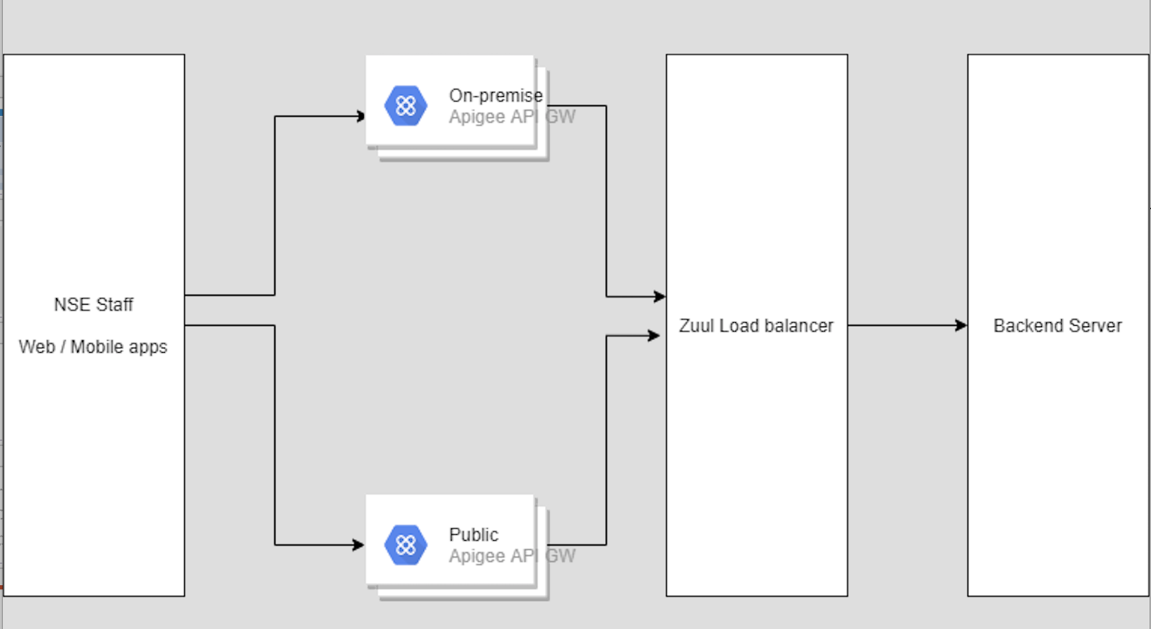
API Gateway Traffic – Internet and Leased Line

